Slide 1
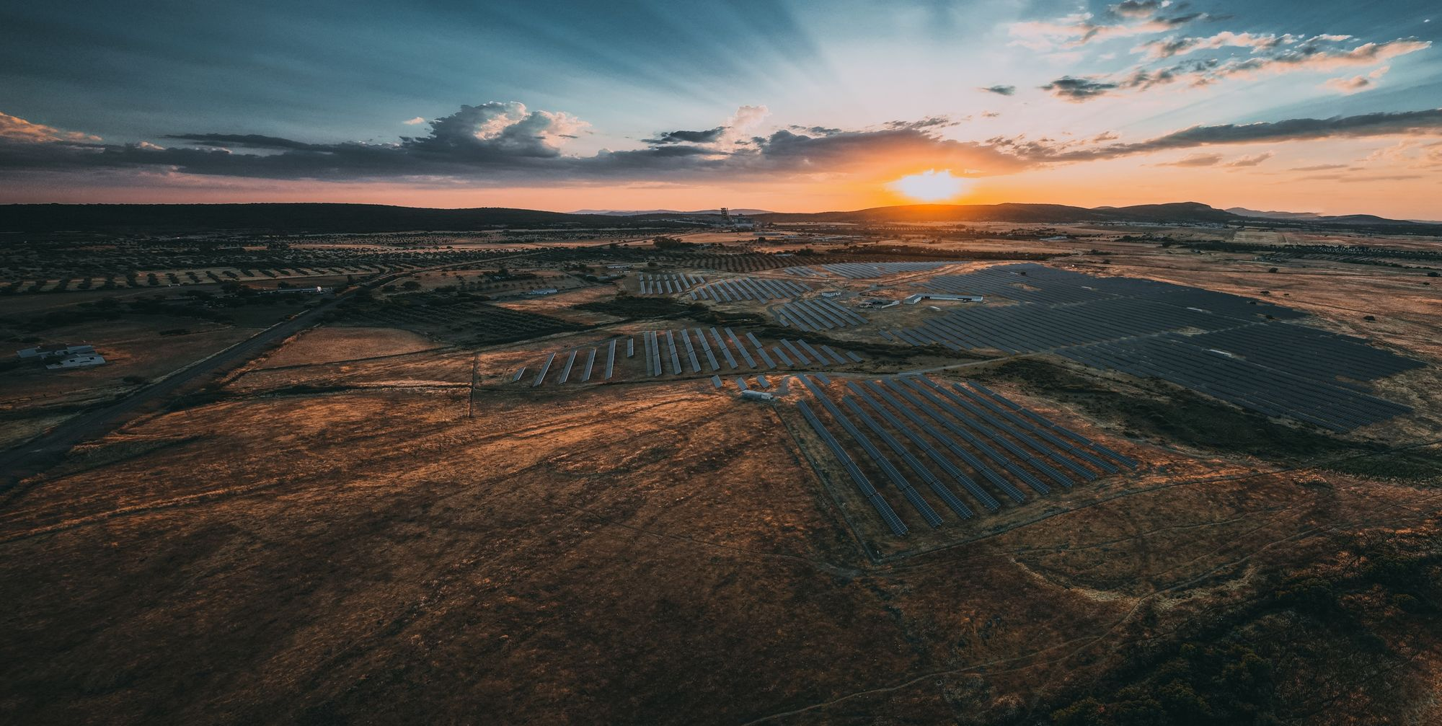
Sonnedix
sustainability
academy
Climate Change (Age 9-13)

Slide 2
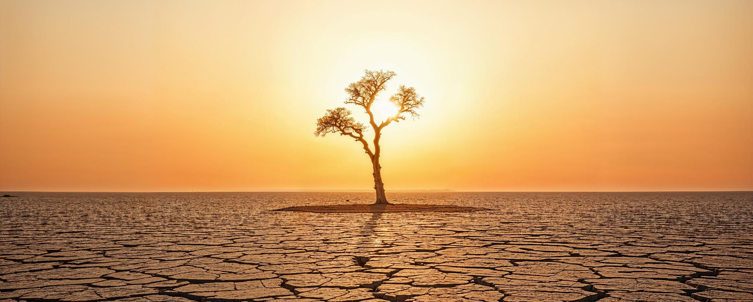
What is climate change?
Have you heard about it?

Slide 3
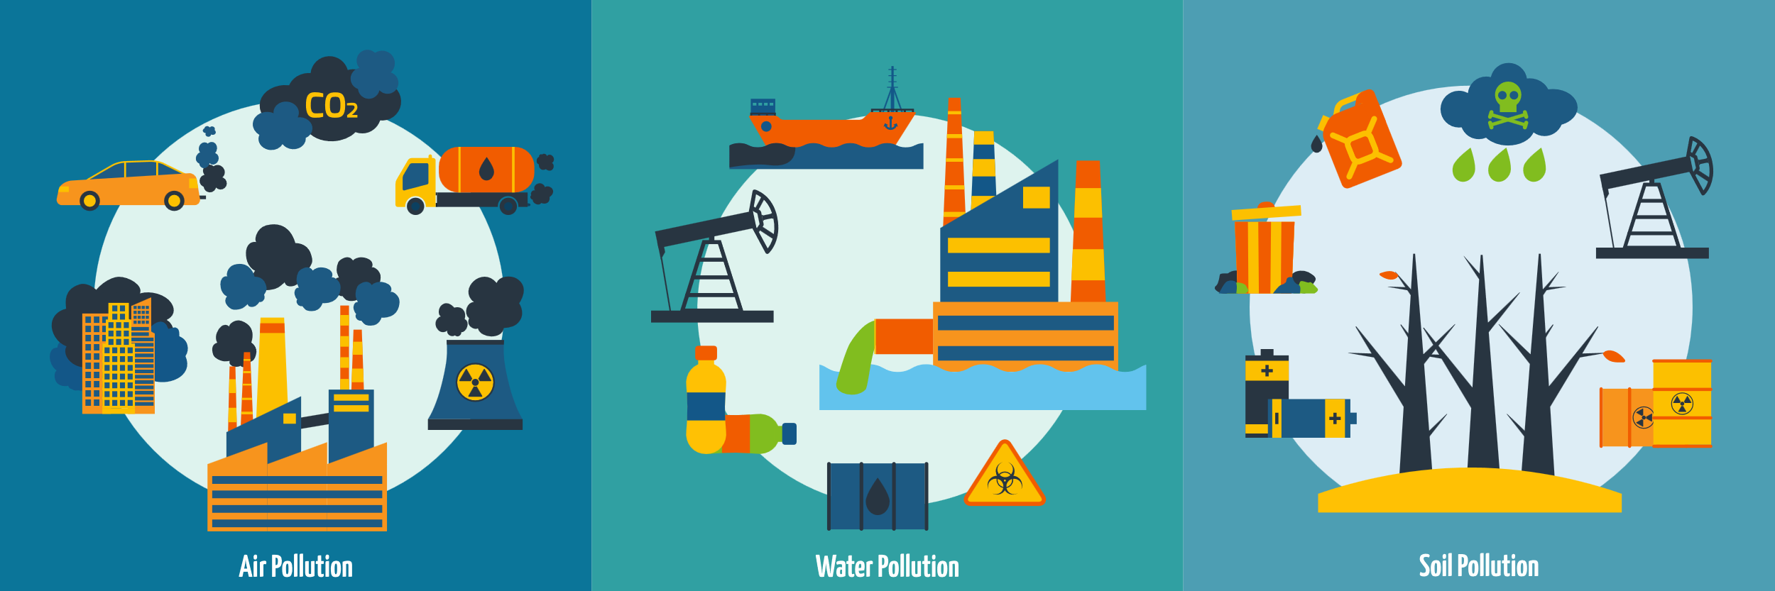
What is causing it?

Slide 4

What is a carbon footprint?
We may not realise it, but we ALL emit carbon dioxide through our day-to-day activities.
Your carbon footprint measures your individual impact on the planet based on the amount of carbon dioxide you emit.
By making different decisions, we can increase or decrease our carbon footprint.
The most common emitters than we can help to reduce are:

Slide 5

ACTIVITY: Thinking about your footprint!

Slide 6






Solving the problem
The role of renewable energy
We can produce electricity through two main sources:
Renewable and non-renewable sources!
Non-renewable energy
comes from resources that are not replaced, or are replaced only very slowly by natural processes.
Renewable energy
is energy from sources that are naturally replenishing.

Slide 7
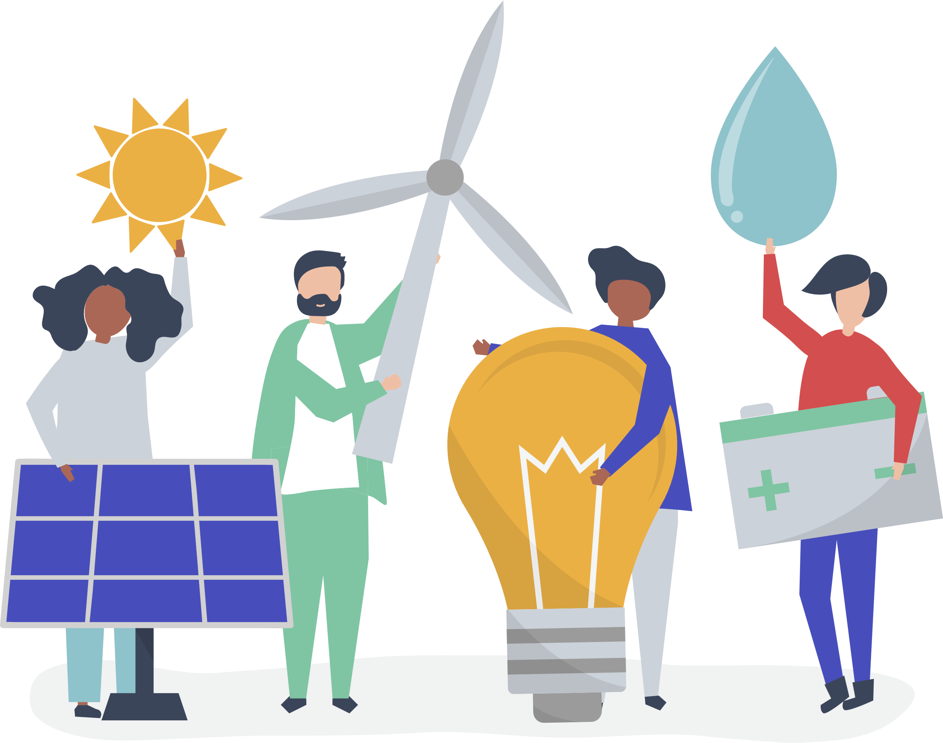
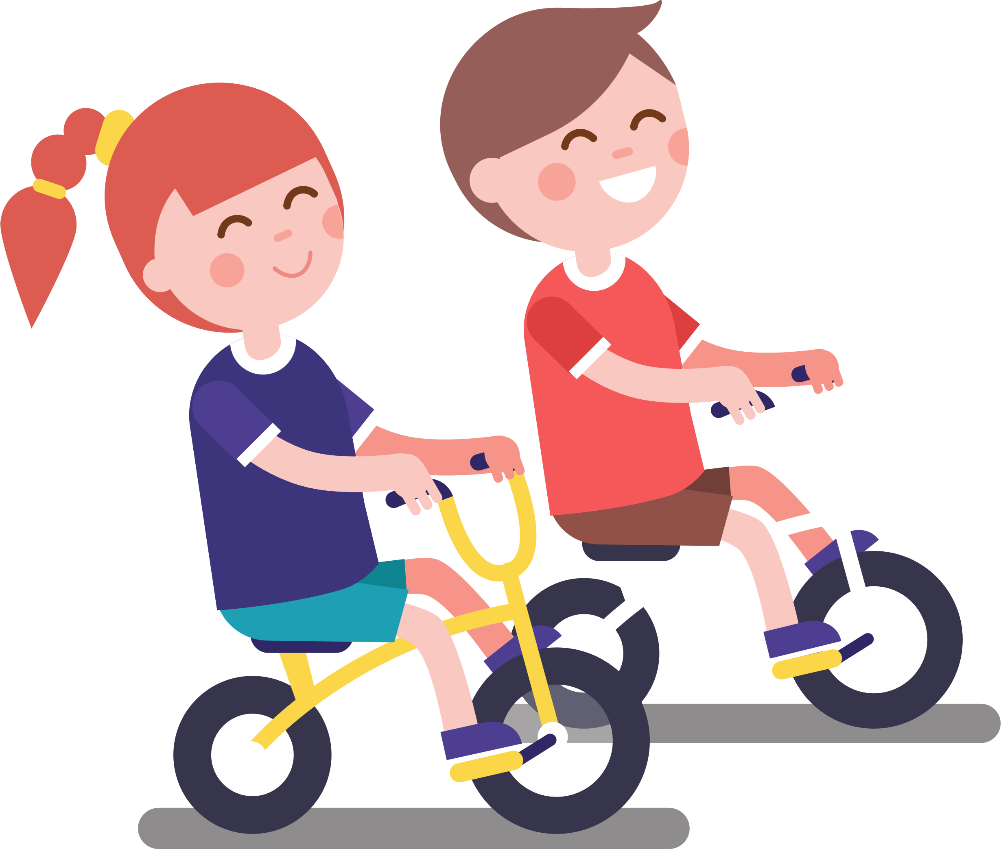

What can you do?
Protect the planet
1
2
3
Use less electricity or
a different type!
Use the car less!
Eat less meat!

Slide 8
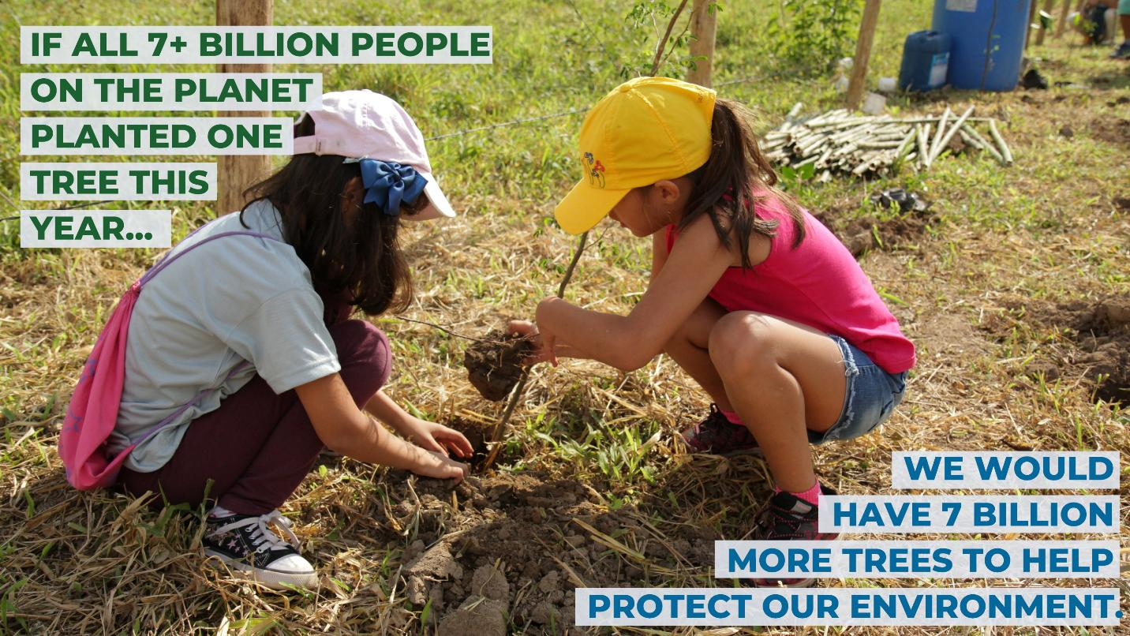
We can plant trees

Slide 9
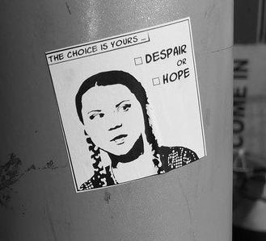
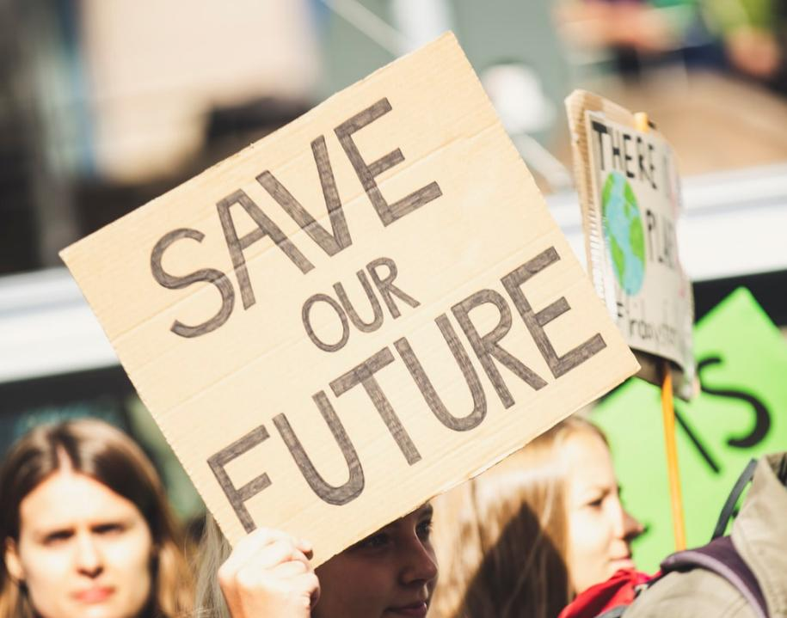
Talk about climate change
Speak up and inspire others to make a change

Slide 10
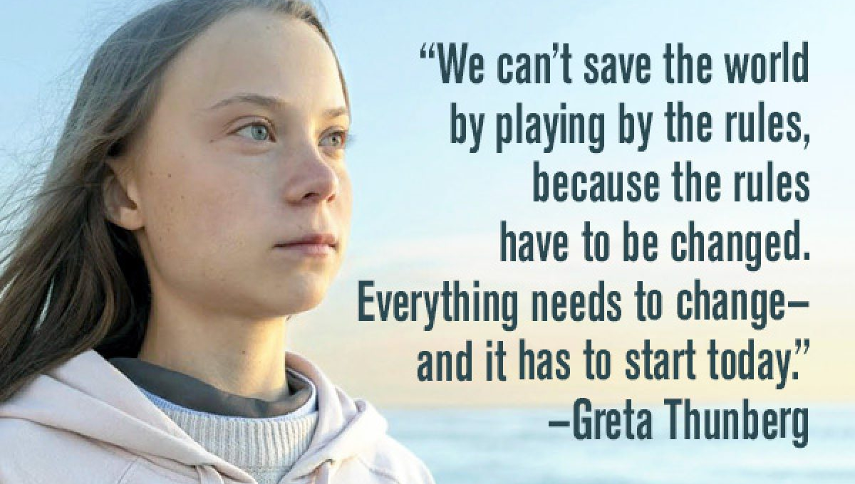

Slide 11

ACTIVITY: Make a pledge!

