Slide 1
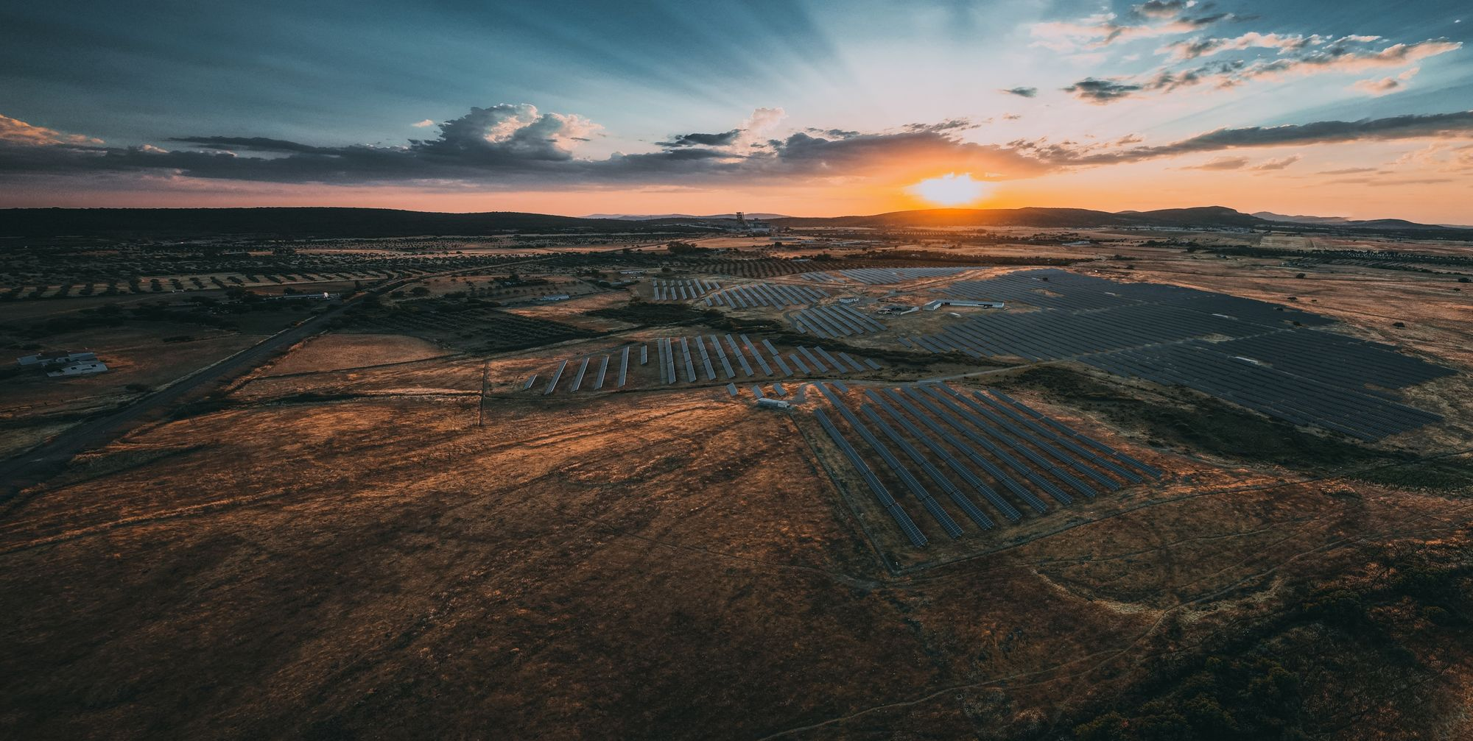
Sonnedix
sustainability
academy
Powering a Bright Future:
An intro to solar energy (secondary)

Slide 2



Imagining a world without electricity

Slide 3
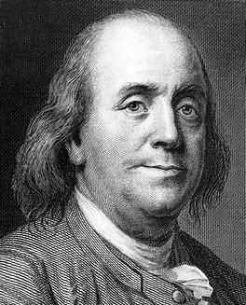
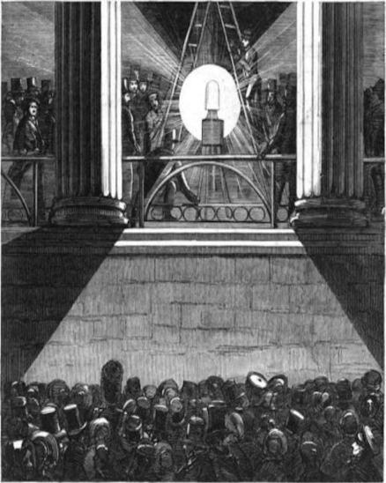

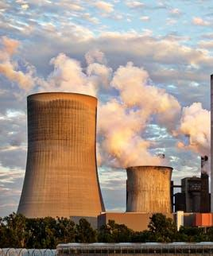
What is electricity?
Electricity is a big part of our lives, and sometimes we don’t even realize it.
First, let’s take a look at what electricity is.

Slide 4
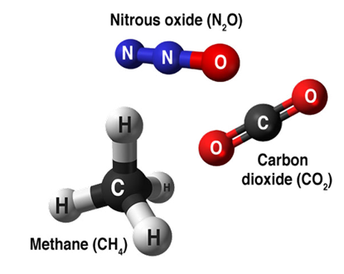
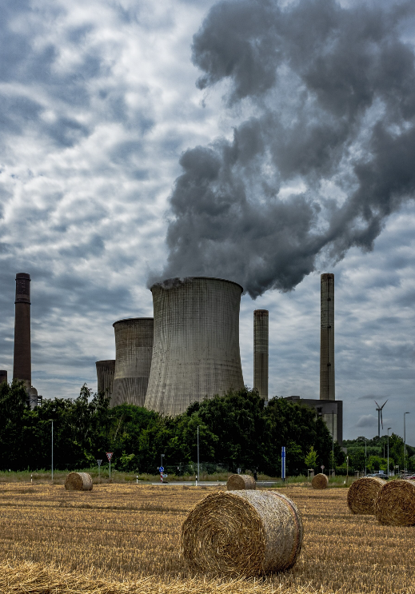


GHG’s and electricity
N20
CO2
Since the industrial revolution, human activities have extracted huge amounts of gas, oil and coal from the ground to burn them to create energy.
This releases large amounts of CO₂, CH₄
and N₂O into the atmosphere.
The concentration of these gases has increased, leading to additional greenhouse effect: this is what causes global warming.
Coal power plant

Slide 5
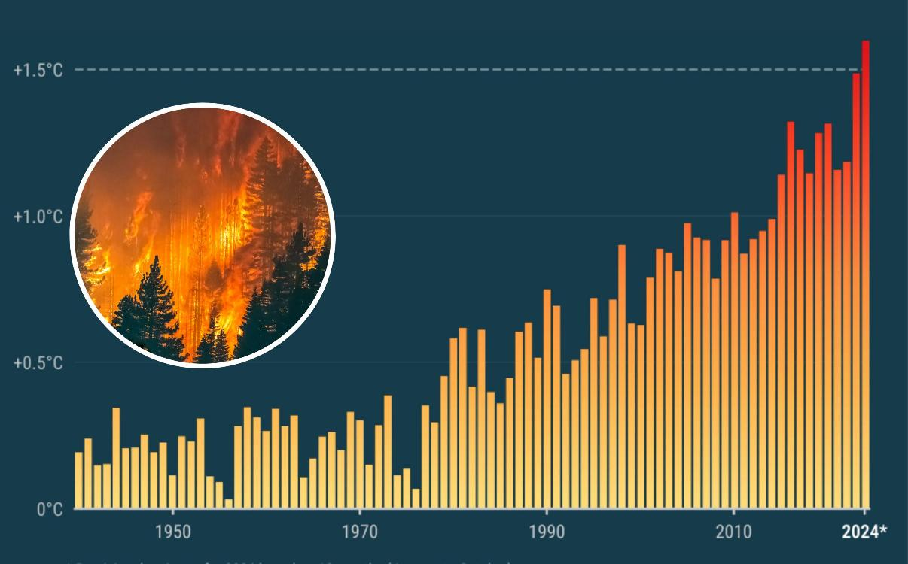
What is climate change?
The Earth’s climate has changed throughout history.
Within the Earth’s history, there have been numerous examples of a changing climate.
The beginning of the modern climate era began 11,700
years ago with the end of
the last ice age.
So why is current climate change an issue?
The current climate change is of particular significance because it is extremely likely to be the result of human activity and is occurring at a much faster rate.

Slide 6

What is causing it?

Slide 7






Solving the problem
The role of renewable energy
We can produce electricity through two main sources:
Renewable and non-renewable sources!
Non-renewable energy
comes from resources that are not replaced, or are replaced only very slowly by natural processes.
Renewable energy
is energy from sources that are naturally replenishing.

Slide 8




What is solar energy?
The photovoltaic effect was explained by Einstein, which earned him the 1921 Nobel Prize in Physics.
It converts the photon energy in light into electricity (via electrons).
01
02
03
The sunglight shines onto the solar panels
The solar panel, containing solar cells, converts the suns energy into electricity
The solar power can then be used to produce electricity to power everything!
DID YOU
KNOW?
Solar PV panels are usually made of silicon, which is nothing more than purified sand!

Slide 9






1MW of solar pv…
POWER
~200
1MW of solar PV is the equivalent of one football pitch!
HOMES
per year*
Avoids an average
1,000mt
of CO₂ emissions
per year
1 hectare
DID YOU
KNOW?
It takes sunlight an average of 8 minutes and 20 seconds to travel from the sun to the Earth’s surface!

Slide 10
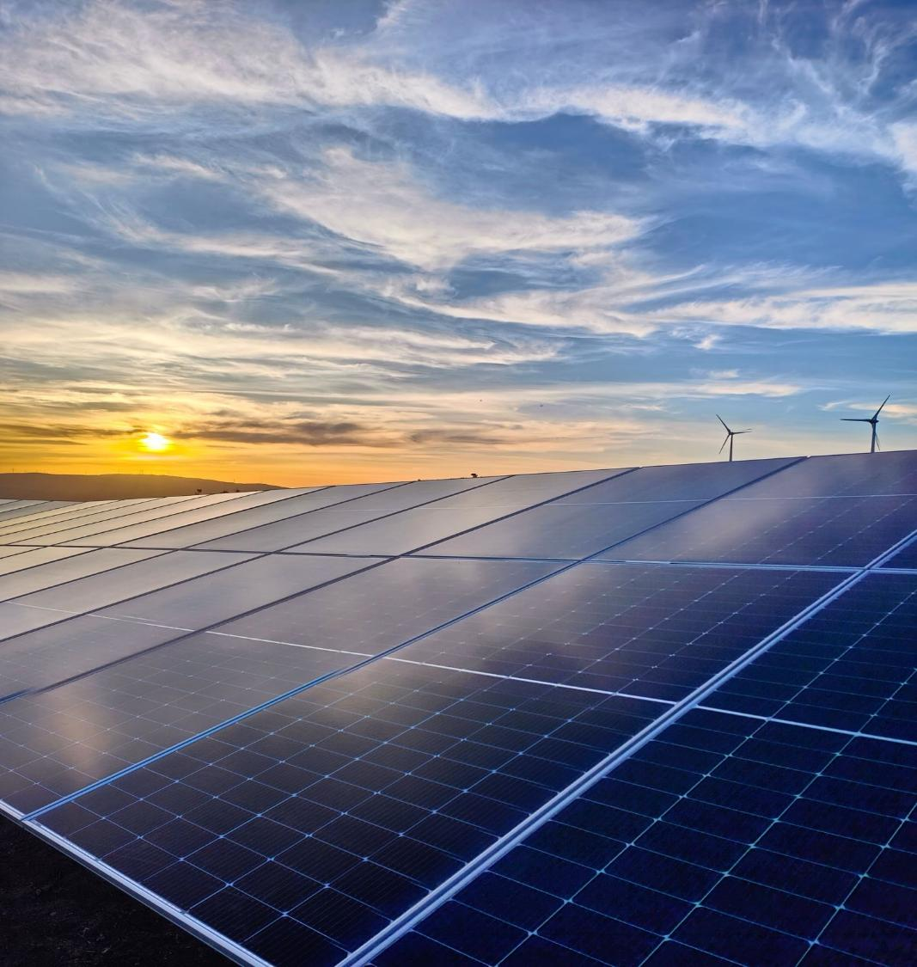




Why do we need renewable energy?
For climate change!
Less impact
on animals!
Less
pollution!
The sun won’t run out!

Slide 11
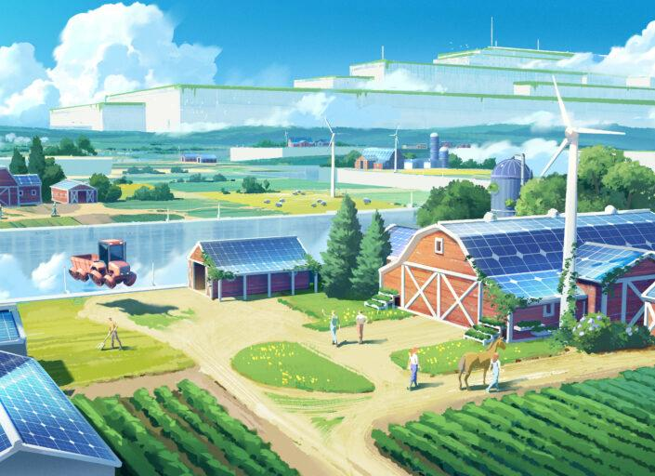
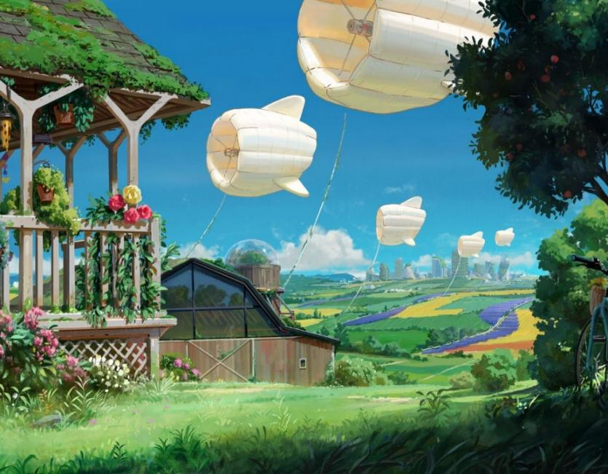
The future?

Slide 12

Our vision is to
Power a Bright Future!
What´s yours?
We urge everyone to become leaders in climate change, to spread the word, and to be a part of the climate solution.

Slide 13

ACTIVITY: Make a pledge!
Email your pledge at esg@sonnedix.com

Slide 14

Thank you for playing your part to fight climate change!
Do you want to know more? If so, find more resources about climate change, solar and other topics related to sustainable development at Sonnedix Sustainability Academy:
www.sonnedix.com/sustainability-academy

